Slide 1
Chapter 7 - Pointers
Outline
7.1 Introduction
7.2 Pointer Variable Definitions and Initialization
7.3 Pointer Operators
7.4 Calling Functions by Reference
7.5 Using the const Qualifier with Pointers
7.6 Bubble Sort Using Call by Reference
7.7 Pointer Expressions and Pointer Arithmetic
7.8 The Relationship between Pointers and Arrays
7.9 Arrays of Pointers
7.10 Case Study: A Card Shuffling and Dealing Simulation
7.11 Pointers to Functions

Slide 2
Objectives
In this chapter, you will learn:
  To be able to use pointers.
  To be able to use pointers to pass arguments to functions using call by reference.
  To understand the close relationships among pointers, arrays and strings.
  To understand the use of pointers to functions.
  To be able to define and use arrays of strings.

Slide 3
7.1 Introduction
Pointers
  Powerful, but difficult to master
  Simulate call-by-reference
  Close relationship with arrays and strings

Slide 4
7.2 Pointer Variable Definitions and Initialization
Pointer variables
  Contain memory addresses as their values
  Normal variables contain a specific value (direct reference)
  Pointers contain address of a variable that has a specific value (indirect reference)
  Indirection – referencing a pointer value
count
7
countPtr
count
7

Slide 5
7.2 Pointer Variable Definitions and Initialization
Pointer definitions
  * used with pointer variables
      int *myPtr;
  Defines a pointer to an int (pointer of type int *)
  Multiple pointers require using a * before each variable definition
      int *myPtr1, *myPtr2;
  Can define pointers to any data type
  Initialize pointers to 0, NULL, or an address
    0 or NULL – points to nothing (NULL preferred)

Slide 6
7.3 Pointer Operators
& (address operator)
  Returns address of operand
    int y = 5;
    int *yPtr;
    yPtr = &y; /* yPtr gets address of y */
    yPtr “points to” y
y
yptr
y
yPtr
5
500000
600000
600000
5
Address of y is value of yptr

Slide 7
7.3 Pointer Operators
* (indirection/dereferencing operator)
  Returns a synonym/alias of what its operand points to
  *yptr returns y (because yptr points to y)
  * can be used for assignment
    Returns alias to an object
      *yptr = 7; /* changes y to 7 */
  Dereferenced pointer (operand of *) must be an lvalue (no constants)
* and & are inverses
  They cancel each other out

Slide 8
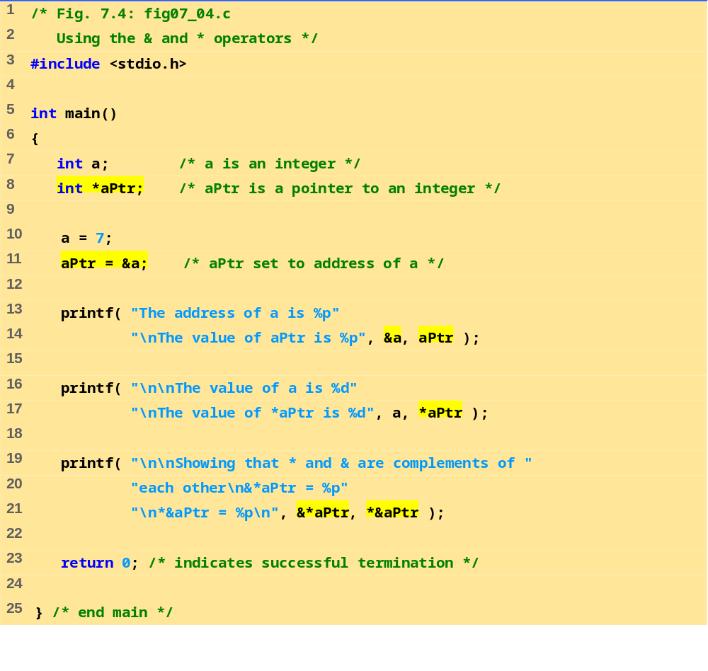
The address of a is the value of aPtr.
fig07_04.c
The * operator returns an alias to what its operand points to. aPtr points to a, so *aPtr returns a.
Notice how * and & are inverses

Slide 9
The address of a is 0012FF7C
The value of aPtr is 0012FF7C
The value of a is 7
The value of *aPtr is 7
Showing that * and & are complements of each other.
&*aPtr = 0012FF7C
*&aPtr = 0012FF7C
Program Output

Slide 10
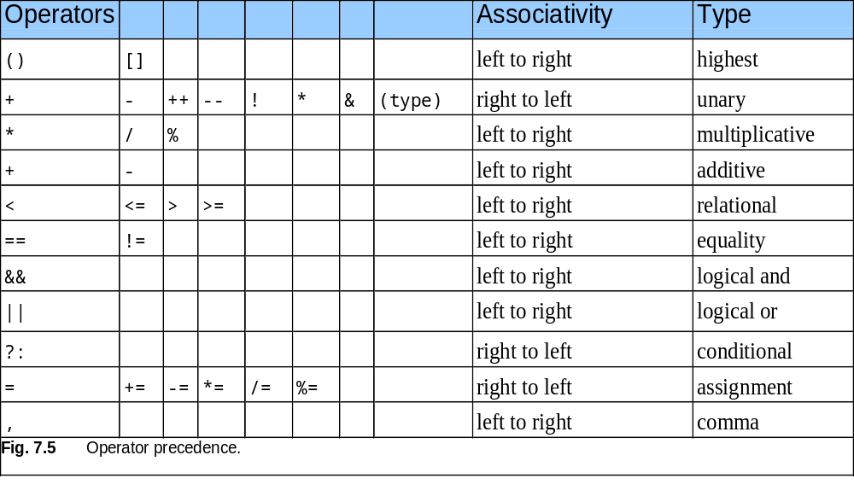
7.3 Pointer Operators

Slide 11
7.4 Calling Functions by Reference
Call by reference with pointer arguments
  Pass address of argument using & operator
  Allows you to change actual location in memory
  Arrays are not passed with & because the array name is already a pointer
* operator
  Used as alias/nickname for variable inside of function
      void double( int *number )
      {
      *number = 2 * ( *number );
      }
  *number used as nickname for the variable passed

Slide 12
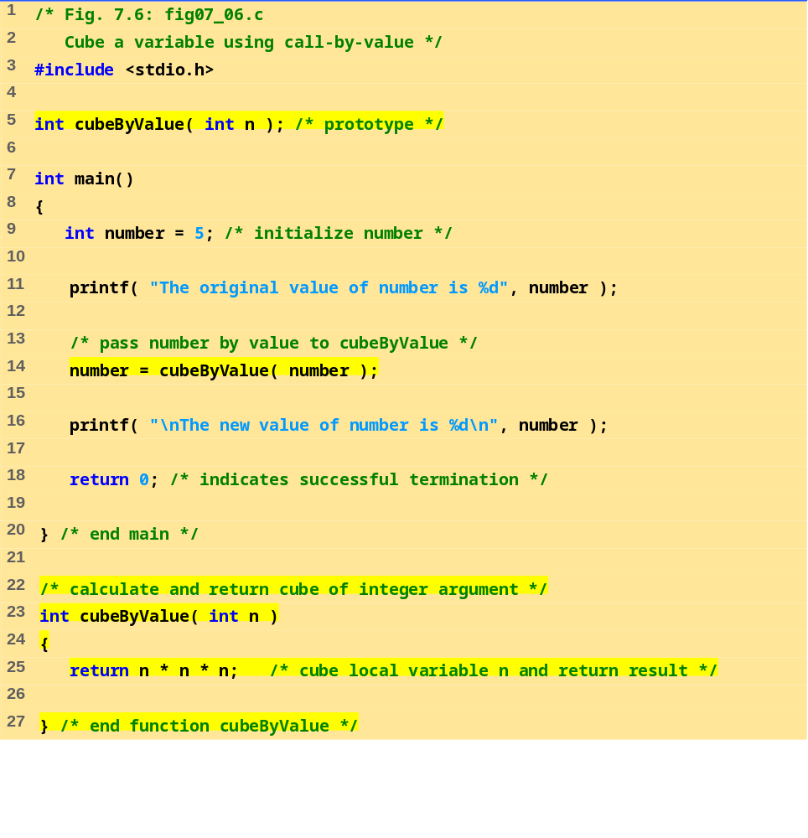
fig07_06.c

Slide 13
The original value of number is 5
The new value of number is 125
Program Output

Slide 14
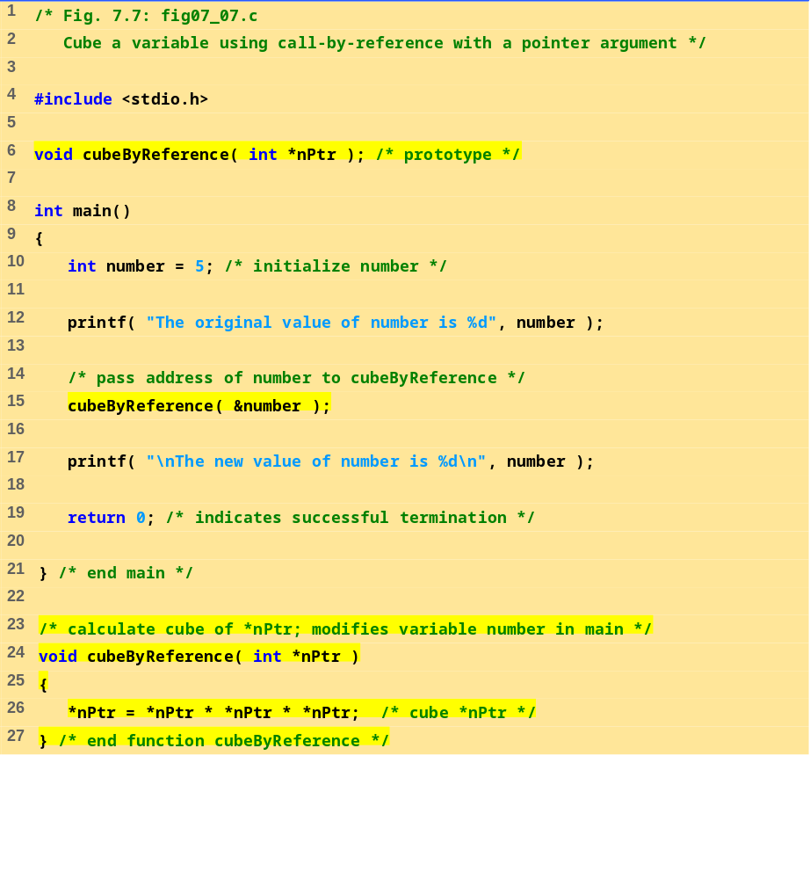
Notice that the function prototype takes a pointer to an integer.
fig07_07.c
Notice how the address of number is given - cubeByReference expects a pointer (an address of a variable).
Inside cubeByReference, *nPtr is used (*nPtr is number).

Slide 15
The original value of number is 5
The new value of number is 125
Program Output

Slide 16
Before
main
calls
cubeByValue
:
int
main()
number
int
cubeByValue(
int
n )
{
{
int
number =
5
5
;
return
n * n * n;
}
n
number=cubeByValue(number);
}
undefined
After
cubeByValue
receives the call:
int
main()
number
int
cubeByValue(
int
n )
{
{
int
number =
5
;
5
return
n * n * n;
}
number = cubeByValue( number );
n
}
5
After
cubeByValue
cubes parameter
n
and before
cubeByValue
returns to
main
:
int
main()
number
int
cubeByValue(
int
n )
{
{
125
int
number =
5
;
5
return
n * n * n;
}
number = cubeByValue( number );
n
}
5
Fig. 7.8 Analysis of a typical call-by-value. (Part 1 of 2.)

Slide 17
After
cubeByValue
returns to
main
and before assigning the result to
number
:
int
main()
number
int
cubeByValue(
int
n )
{
{
int
number =
5
5
;
return
n * n * n;
125
}
number = cubeByValue( number );
n
}
undefined
After
main
completes the assignment to
number
:
int
main()
number
int
cubeByValue(
int
n )
{
{
int
number =
5
;
125
return
n * n * n;
125
125
}
number = cubeByValue( number );
n
}
undefined
Fig. 7.8 Analysis of a typical call-by-value. (Part 2 of 2.)

Slide 18
Before
main
calls
cubeByReference
:
int
main()
number
void
cubeByReference(
int
*nPtr )
{
5
{
int
number =
5
;
*nPtr = *nPtr * *nPtr * *nPtr;
}
cubeByReference( &number );
nPtr
}
undefined
After
cubeByReference
receives the call and before
*nPtr
is cubed:
int
main()
number
void
cubeByReference(
int
*nPtr )
{
5
{
int
number =
5
;
*nPtr = *nPtr * *nPtr * *nPtr;
}
cubeByReference( &number );
nPtr
}
call establishes this pointer
After
*nPtr
is cubed and before program control returns to
main
:
int
main()
number
void
cubeByReference(
int
*nPtr )
{
125
{
125
int
number =
5
;
*nPtr = *nPtr * *nPtr * *nPtr;
}
cubeByReference( &number );
called function modifies
nPtr
}
caller’s variable
Fig. 7.9 Analysis of a typical call-by-reference with a pointer argument.

Slide 19
7.5 Using the const Qualifier with Pointers
const qualifier
  Variable cannot be changed
  Use const if function does not need to change a variable
  Attempting to change a const variable produces an error
const pointers
  Point to a constant memory location
  Must be initialized when defined
  int *const myPtr = &x;
    Type int *const – constant pointer to an int
  const int *myPtr = &x;
    Regular pointer to a const int
  const int *const Ptr = &x;
    const pointer to a const int
    x can be changed, but not *Ptr

Slide 20
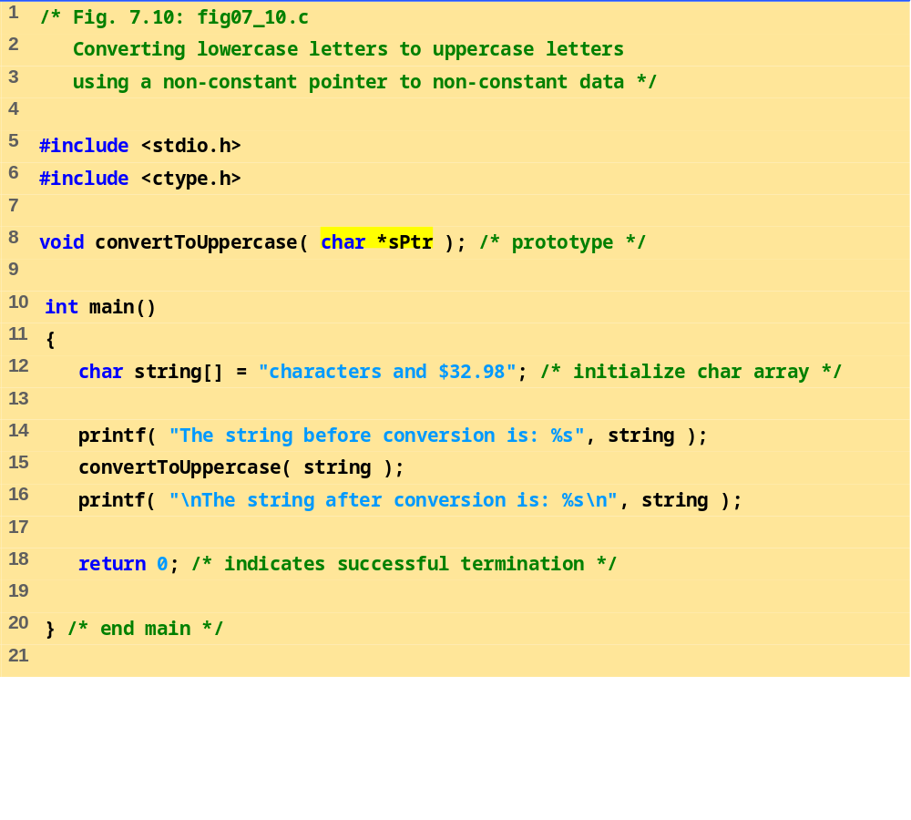
fig07_10.c (Part 1 of 2)

Slide 21
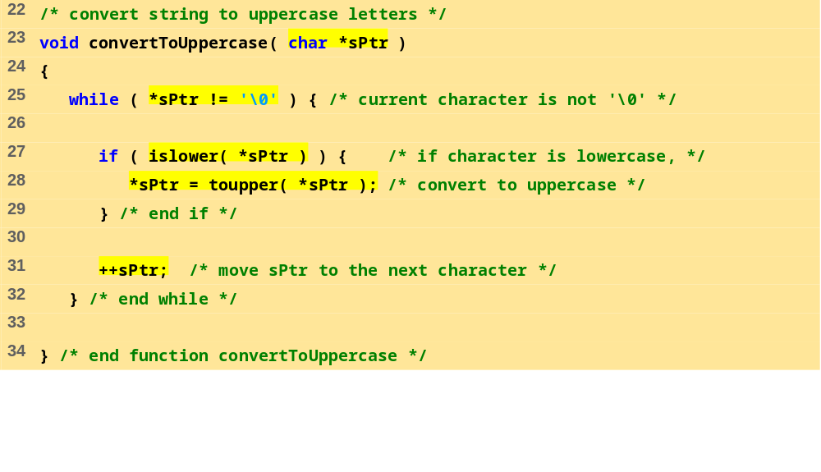
fig07_10.c (Part 2 of 2)
Program Output
The string before conversion is: characters and $32.98
The string after conversion is: CHARACTERS AND $32.98

Slide 22
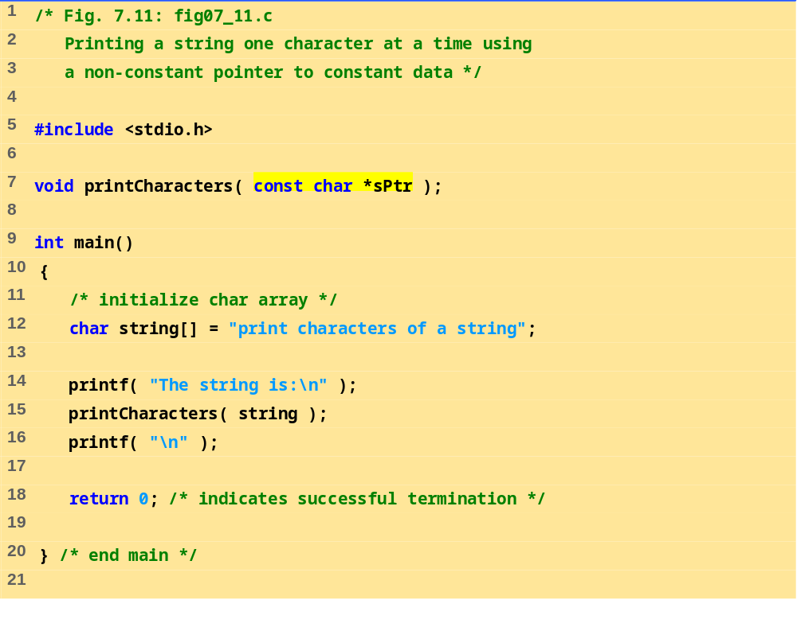
fig07_11.c (Part 1 of 2)

Slide 23
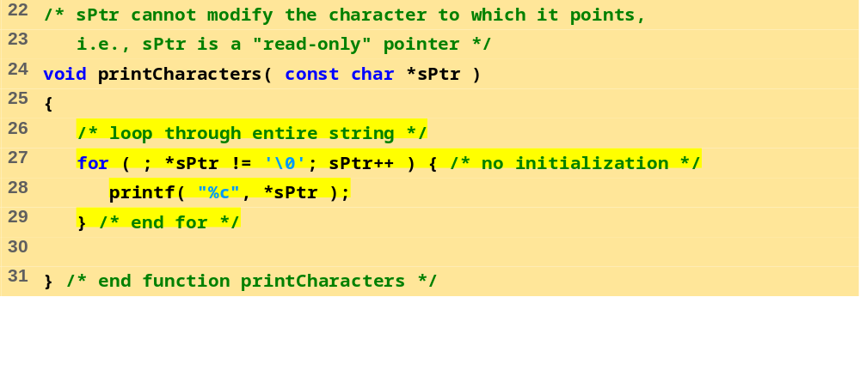
fig07_11.c (Part 2 of 2)
Program Output
The string is:
print characters of a string

Slide 24
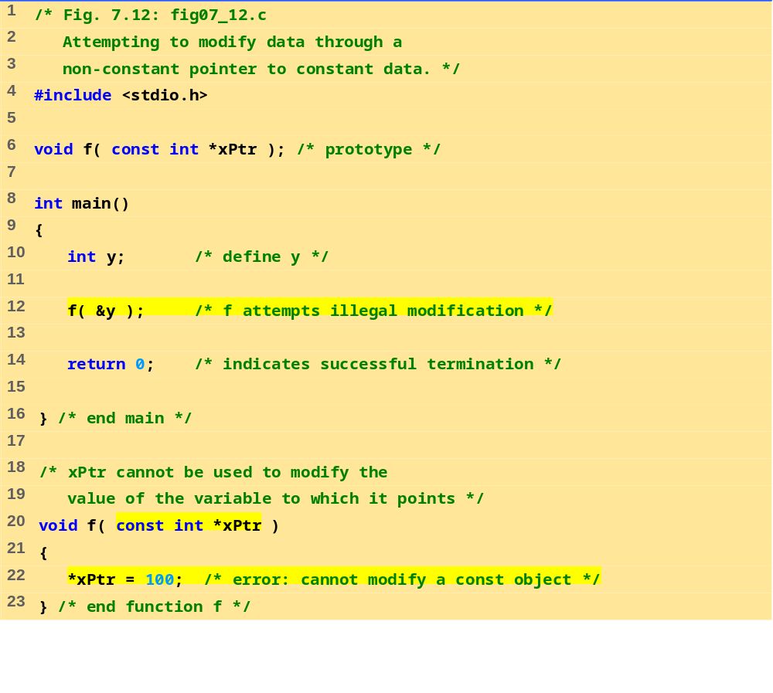
fig07_12.c

Slide 25
Compiling...
FIG07_12.c
d:\books\2003\chtp4\examples\ch07\fig07_12.c(22) : error C2166: l-value
specifies const object
Error executing cl.exe.
FIG07_12.exe - 1 error(s), 0 warning(s)
Program Output

Slide 26
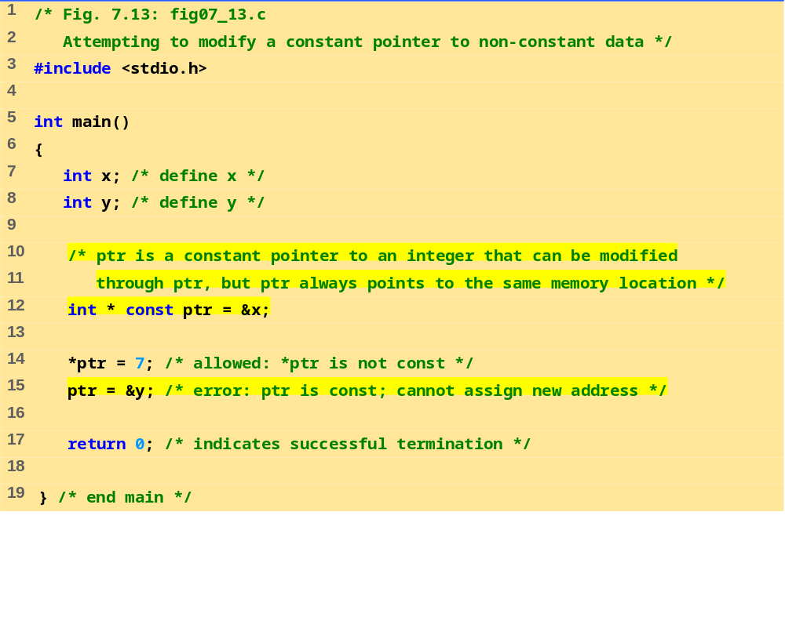
fig07_13.c
Program Output
Changing *ptr is allowed – x is not a constant.
Changing ptr is an error – ptr is a constant pointer.
Compiling...
FIG07_13.c
D:\books\2003\chtp4\Examples\ch07\FIG07_13.c(15) : error C2166: l-value
specifies­ const object
Error executing cl.exe.
FIG07_13.exe - 1 error(s), 0 warning(s)

Slide 27
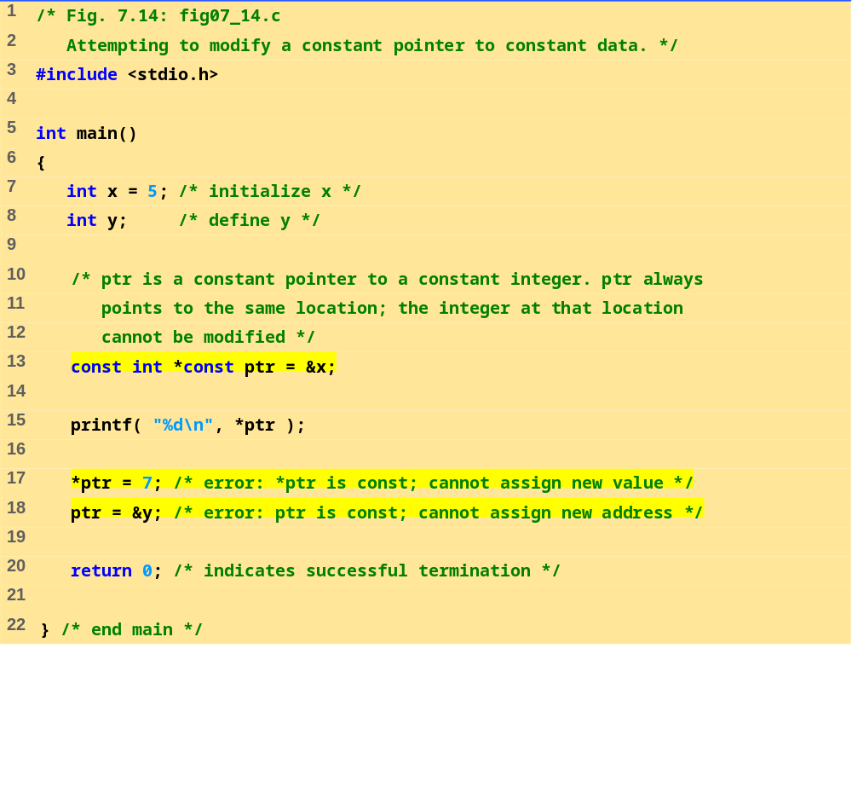
fig07_14.c

Slide 28
Compiling...
FIG07_14.c
D:\books\2003\chtp4\Examples\ch07\FIG07_14.c(17) : error C2166: l-value
specifies­ const object
D:\books\2003\chtp4\Examples\ch07\FIG07_14.c(18) : error C2166: l-value
specifies­ const object
Error executing cl.exe.
FIG07_12.exe - 2 error(s), 0 warning(s)
Program Output

Slide 29
7.6 Bubble Sort Using Call-by-reference
Implement bubblesort using pointers
  Swap two elements
  swap function must receive address (using &) of array elements
    Array elements have call-by-value default
  Using pointers and the * operator, swap can switch array elements
Psuedocode
    Initialize array
    print data in original order
    Call function bubblesort
    print sorted array
    Define bubblesort

Slide 30
7.6 Bubble Sort Using Call-by-reference
sizeof
  Returns size of operand in bytes
  For arrays: size of 1 element * number of elements
  if sizeof( int ) equals 4 bytes, then
      int myArray[ 10 ];
      printf( "%d", sizeof( myArray ) );
    will print 40
sizeof can be used with
  Variable names
  Type name
  Constant values

Slide 31
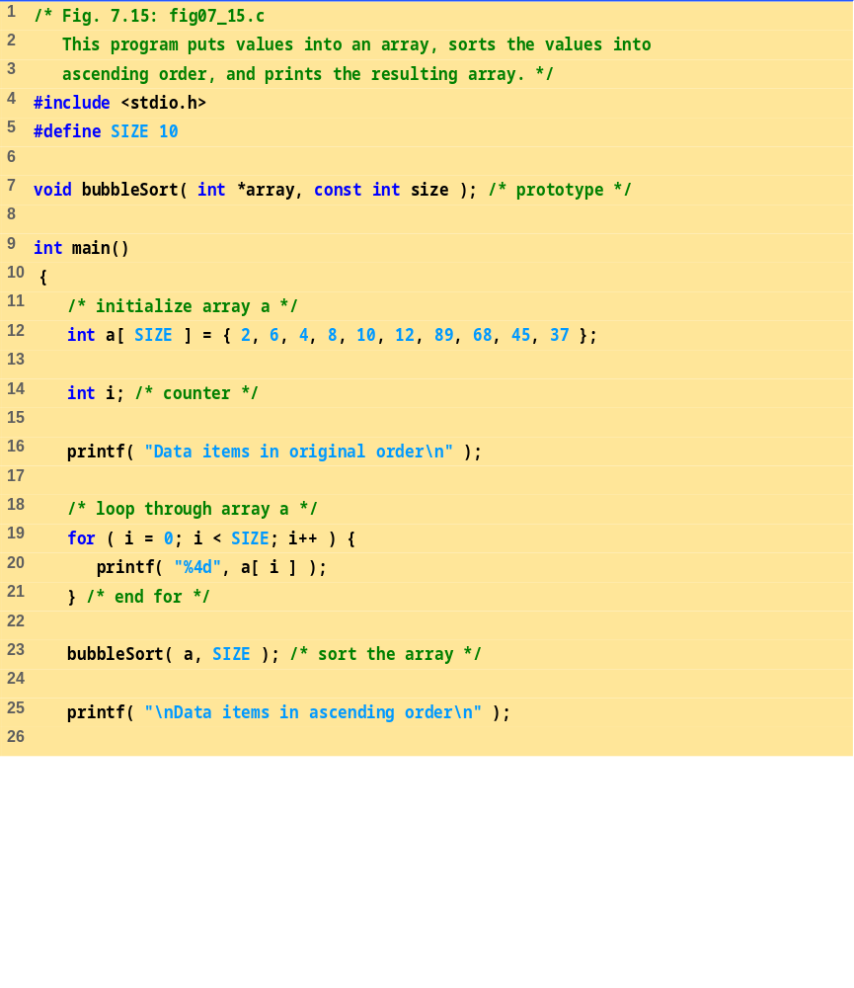
fig07_15.c (Part 1 of 3)
Bubblesort gets passed the address of array elements (pointers). The name of an array is a pointer.

Slide 32
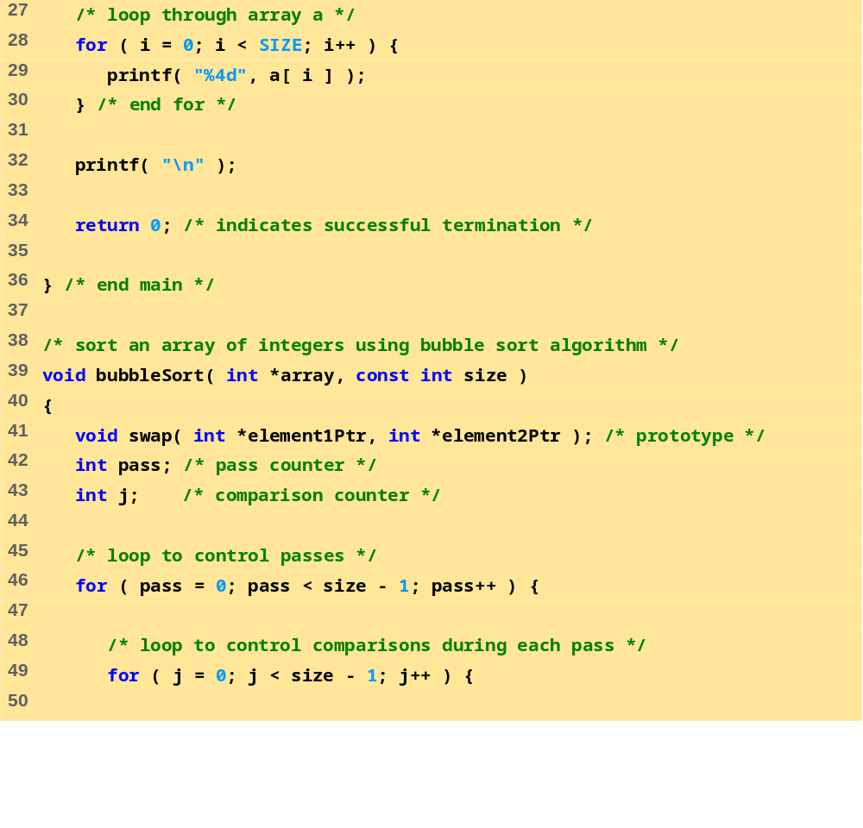
fig07_15.c (Part 2 of 3)

Slide 33
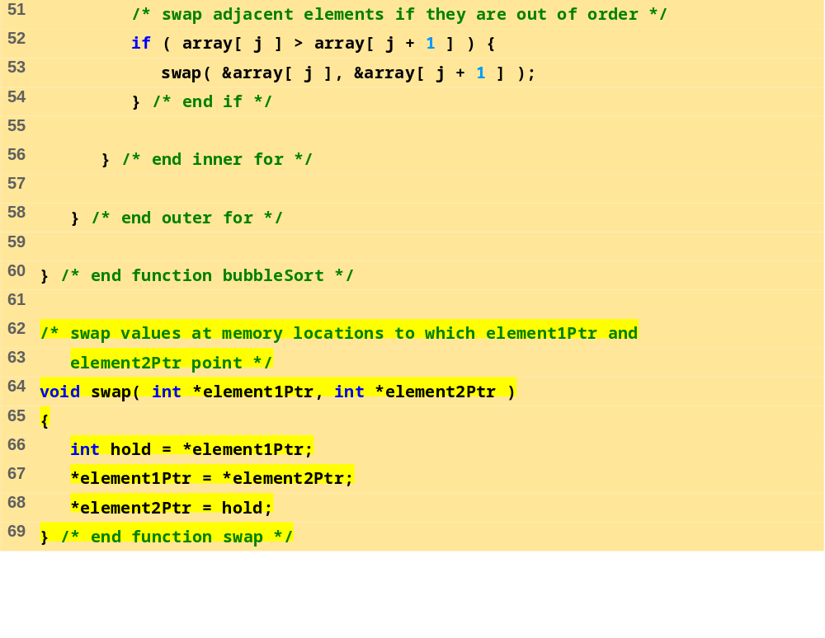
fig07_15.c (Part 3 of 3)
Program Output
Data items in original order
2 6 4 8 10 12 89 68 45 37
Data items in ascending order
2 4 6 8 10 12 37 45 68 89

Slide 34
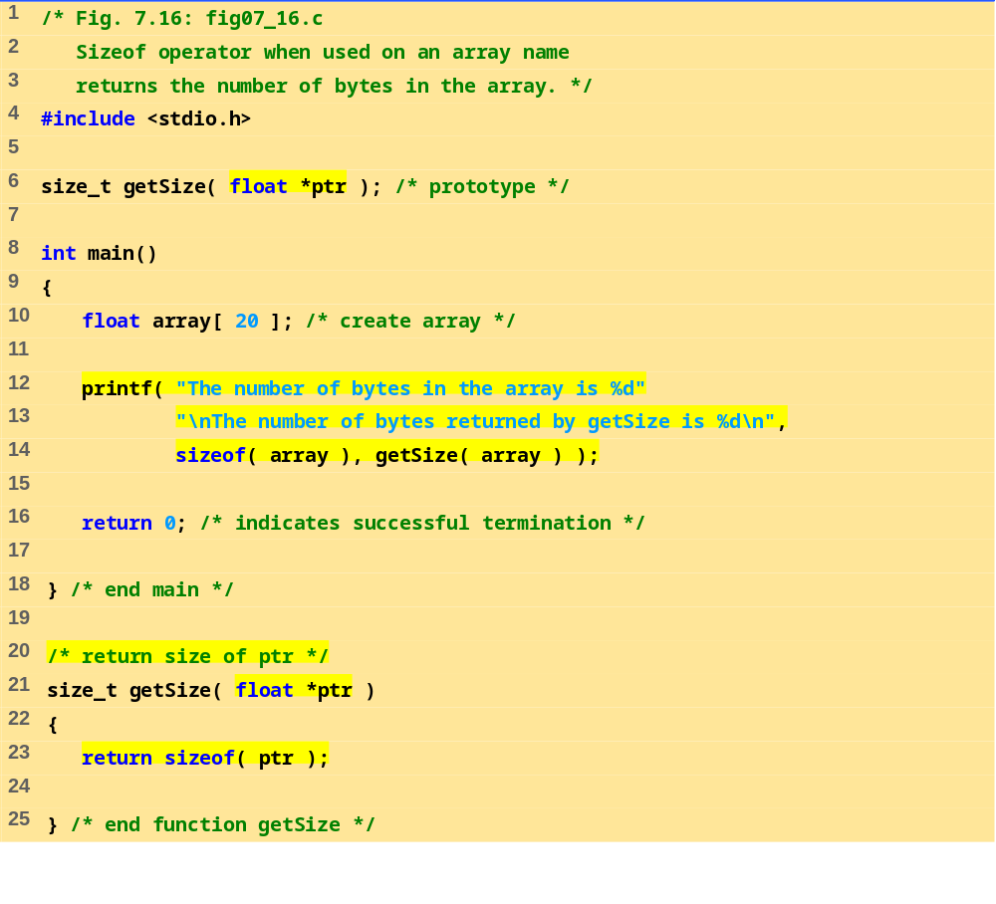
fig07_16.c
Program Output
The number of bytes in the array is 80
The number of bytes returned by getSize is 4

Slide 35
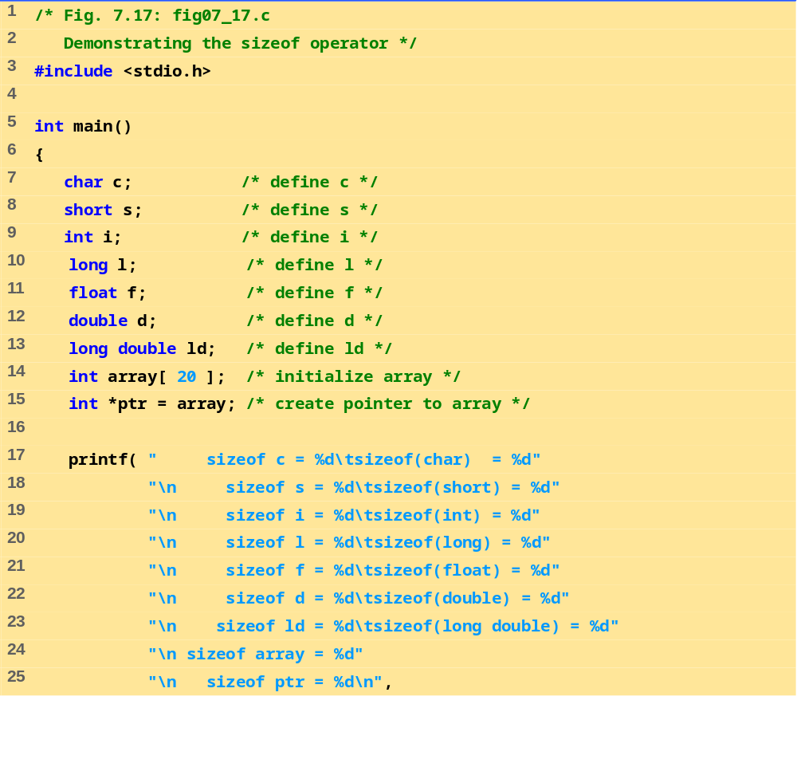
fig07_17.c (Part 1 of 2)

Slide 36
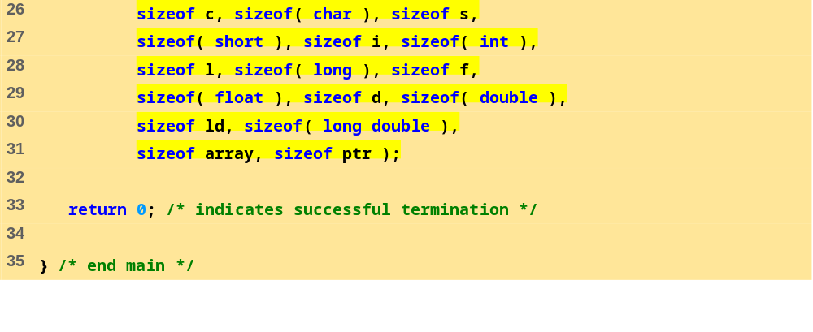
fig07_17.c (Part 2 of 2)
Program Output
sizeof c = 1 sizeof(char) = 1
sizeof s = 2 sizeof(short) = 2
sizeof i = 4 sizeof(int) = 4
sizeof l = 4 sizeof(long) = 4
sizeof f = 4 sizeof(float) = 4
sizeof d = 8 sizeof(double) = 8
sizeof ld = 8 sizeof(long double) = 8
sizeof array = 80
sizeof ptr = 4

Slide 37
7.7 Pointer Expressions and Pointer Arithmetic
Arithmetic operations can be performed on pointers
  Increment/decrement pointer (++ or --)
  Add an integer to a pointer( + or += , - or -=)
  Pointers may be subtracted from each other
  Operations meaningless unless performed on an array

Slide 38
7.7 Pointer Expressions and Pointer Arithmetic
5 element int array on machine with 4 byte ints
  vPtr points to first element v[ 0 ]
    at location 3000 (vPtr = 3000)
  vPtr += 2; sets vPtr to 3008
    vPtr points to v[ 2 ] (incremented by 2), but the machine has 4 byte ints, so it points to address 3008
location
3000
3004
3008
3012
3016
v[0]
v[1]
v[2]
v[3]
v[4]
pointer variable vPtr

Slide 39
7.7 Pointer Expressions and Pointer Arithmetic
Subtracting pointers
  Returns number of elements from one to the other. If
    vPtr2 = v[ 2 ];
    vPtr = v[ 0 ];
  vPtr2 - vPtr would produce 2
Pointer comparison ( <, == , > )
  See which pointer points to the higher numbered array element
  Also, see if a pointer points to 0

Slide 40
7.7 Pointer Expressions and Pointer Arithmetic
Pointers of the same type can be assigned to each other
  If not the same type, a cast operator must be used
  Exception: pointer to void (type void *)
    Generic pointer, represents any type
    No casting needed to convert a pointer to void pointer
    void pointers cannot be dereferenced

Slide 41
7.8 The Relationship Between Pointers and Arrays
Arrays and pointers closely related
  Array name like a constant pointer
  Pointers can do array subscripting operations
Define an array b[ 5 ] and a pointer bPtr
  To set them equal to one another use:
      bPtr = b;
    The array name (b) is actually the address of first element of the array b[ 5 ]
      bPtr = &b[ 0 ]
    Explicitly assigns bPtr to address of first element of b

Slide 42
7.8 The Relationship Between Pointers and Arrays
  Element b[ 3 ]
    Can be accessed by *( bPtr + 3 )
      Where n is the offset. Called pointer/offset notation
    Can be accessed by bptr[ 3 ]
      Called pointer/subscript notation
      bPtr[ 3 ] same as b[ 3 ]
    Can be accessed by performing pointer arithmetic on the array itself
      *( b + 3 )

Slide 43
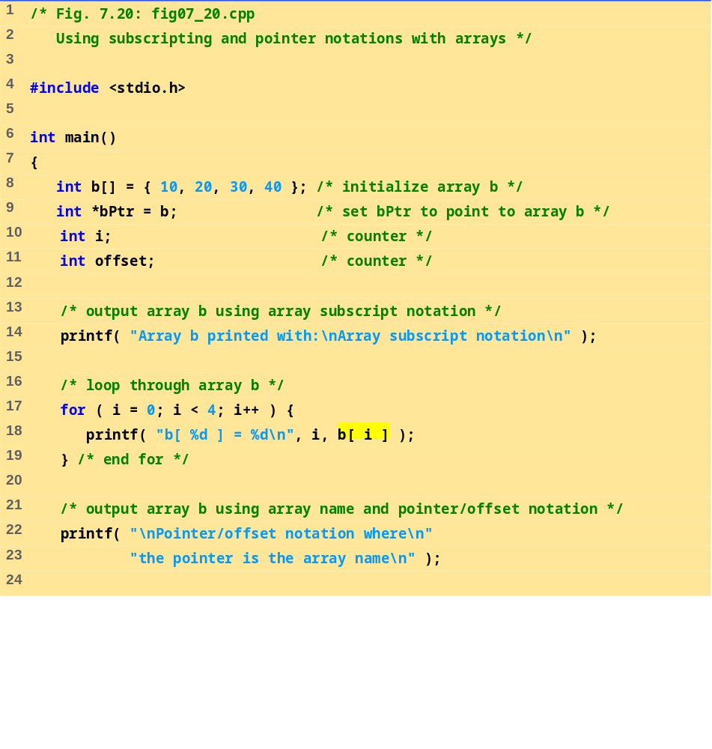
fig07_20.c (Part 1 of 2)

Slide 44
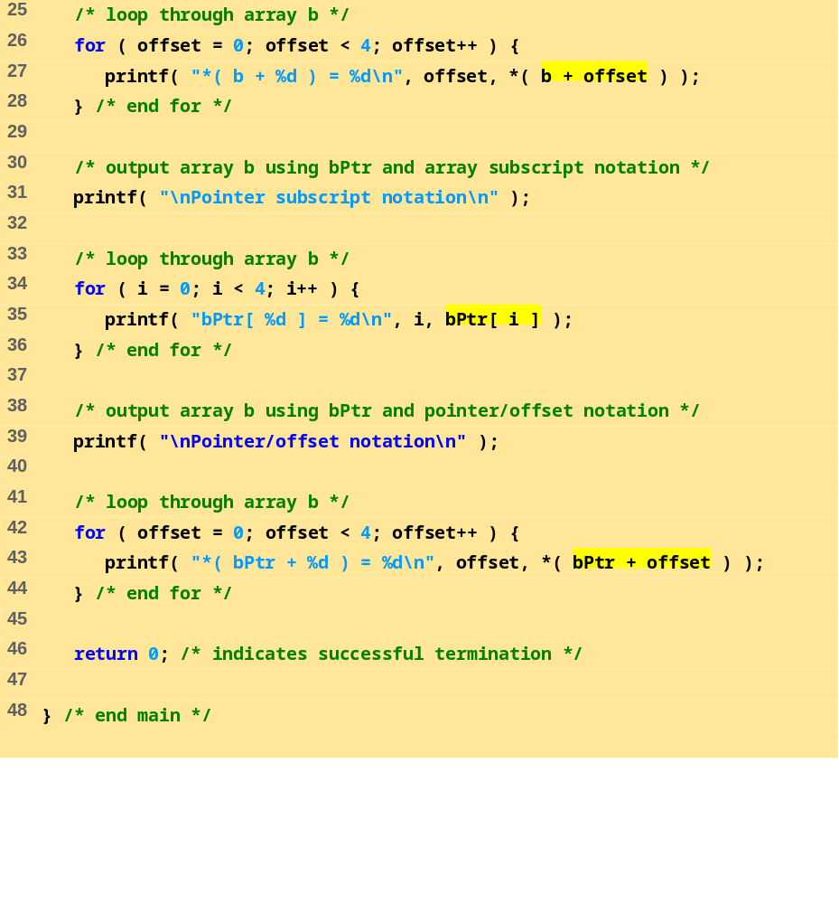
fig07_20.c (Part 2 of 2)

Slide 45
Array b printed with:
Array subscript notation
b[ 0 ] = 10
b[ 1 ] = 20
b[ 2 ] = 30
b[ 3 ] = 40
Pointer/offset notation where
the pointer is the array name
*( b + 0 ) = 10
*( b + 1 ) = 20
*( b + 2 ) = 30
*( b + 3 ) = 40
Pointer subscript notation
bPtr[ 0 ] = 10
bPtr[ 1 ] = 20
bPtr[ 2 ] = 30
bPtr[ 3 ] = 40
Pointer/offset notation
*( bPtr + 0 ) = 10
*( bPtr + 1 ) = 20
*( bPtr + 2 ) = 30
*( bPtr + 3 ) = 40
Program Output

Slide 46
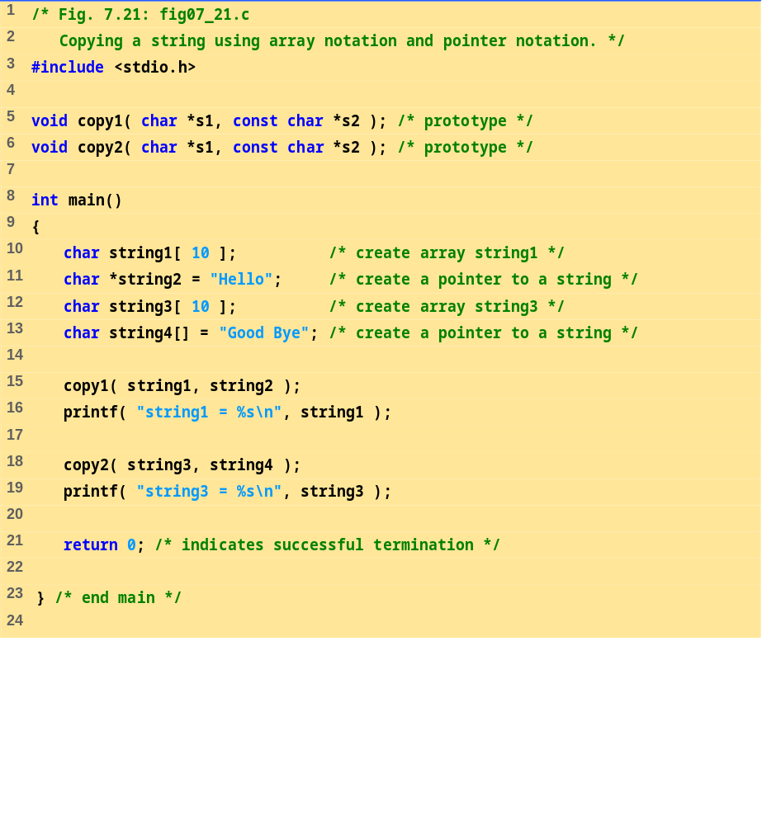
fig07_21.c (Part 1 of 2)

Slide 47
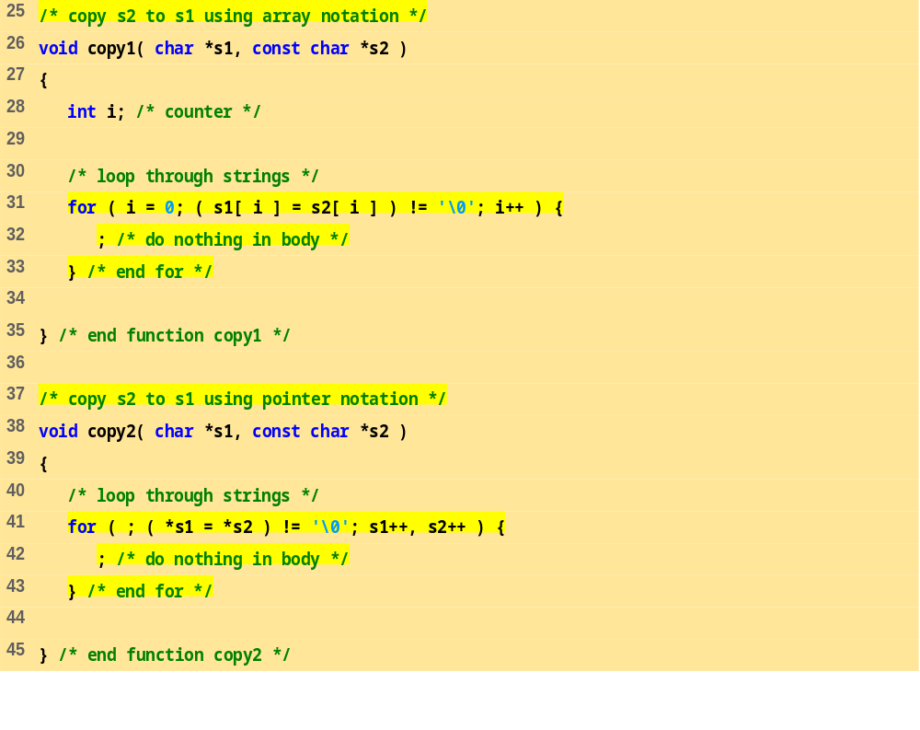
fig07_21.c (Part 2 of 2)
Program Output
string1 = Hello
string3 = Good Bye

Slide 48
7.9 Arrays of Pointers
Arrays can contain pointers
For example: an array of strings
    char *suit[ 4 ] = { "Hearts", "Diamonds",
    "Clubs", "Spades" };
  Strings are pointers to the first character
  char * – each element of suit is a pointer to a char
  The strings are not actually stored in the array suit, only pointers to the strings are stored
  suit array has a fixed size, but strings can be of any size
suit[0]
’H’
’e’
’a’
’r’
’t’
’s’
’\0’
suit[1]
’D’
’i’
’a’
’m’
’o’
’n’
’d’
’s’
’\0’
suit[2]
’C’
’l’
’u’
’b’
’s’
’\0’
suit[3]
’S’
’p’
’a’
’d’
’e’
’s’
’\0’

Slide 49
7.10 Case Study: A Card Shuffling and Dealing Simulation
Card shuffling program
  Use array of pointers to strings
  Use double scripted array (suit, face)
  The numbers 1-52 go into the array
    Representing the order in which the cards are dealt
Ace
Two
Three
Four
Five
Six
Seven
Eight
Nine
Ten
Jack
Queen
King
0
1
2
3
4
5
6
7
8
9
10
11
12
Hearts
0
Diamonds
1
Clubs
2
Spades
3
deck[ 2 ][ 12 ] represents the King of Clubs
Clubs
King

Slide 50
7.10 Case Study: A Card Shuffling and Dealing Simulation
Pseudocode
  Top level:
    Shuffle and deal 52 cards
  First refinement:
    Initialize the suit array
    Initialize the face array
    Initialize the deck array
    Shuffle the deck
    Deal 52 cards

Slide 51
7.10 Case Study: A Card Shuffling and Dealing Simulation
  Second refinement
    Convert shuffle the deck to
      For each of the 52 cards
      Place card number in randomly selected unoccupied slot of deck
    Convert deal 52 cards to
      For each of the 52 cards
      Find card number in deck array and print face and suit of card

Slide 52
7.10 Case Study: A Card Shuffling and Dealing Simulation
  Third refinement
    Convert shuffle the deck to
      Choose slot of deck randomly
      While chosen slot of deck has been previously chosen
      Choose slot of deck randomly
        Place card number in chosen slot of deck
    Convert deal 52 cards to
      For each slot of the deck array
      If slot contains card number
      Print the face and suit of the card

Slide 53
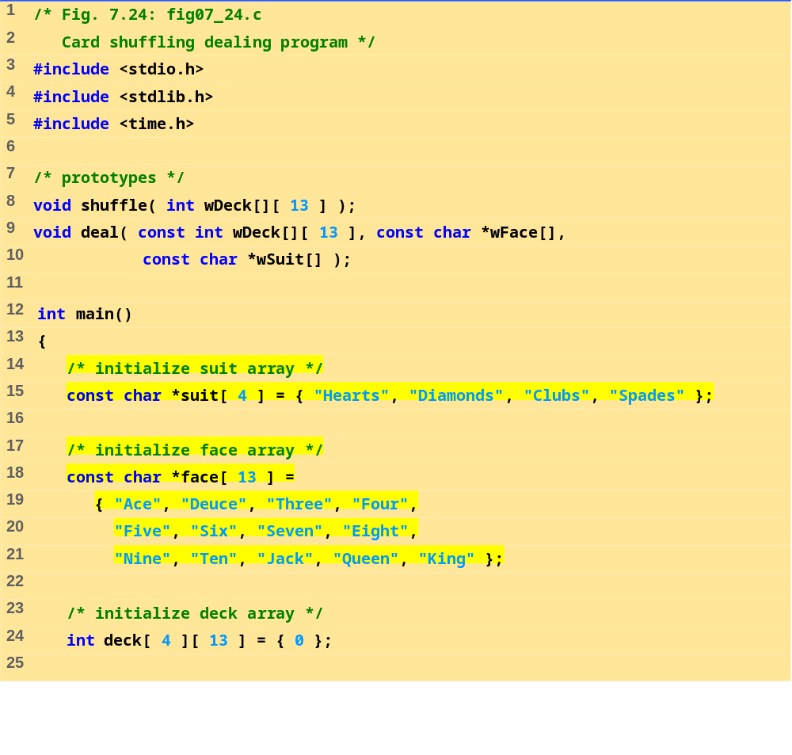
fig07_24.c (Part 1 of 4)

Slide 54
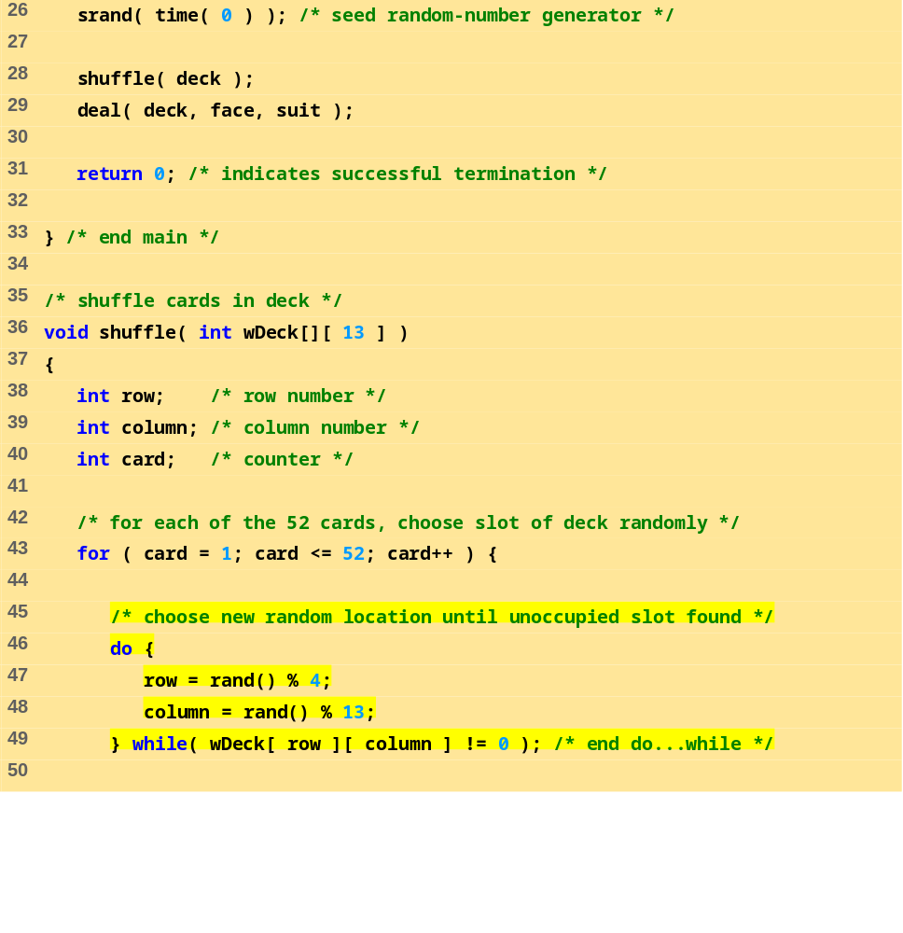
fig07_24.c (Part 2 of 4)

Slide 55
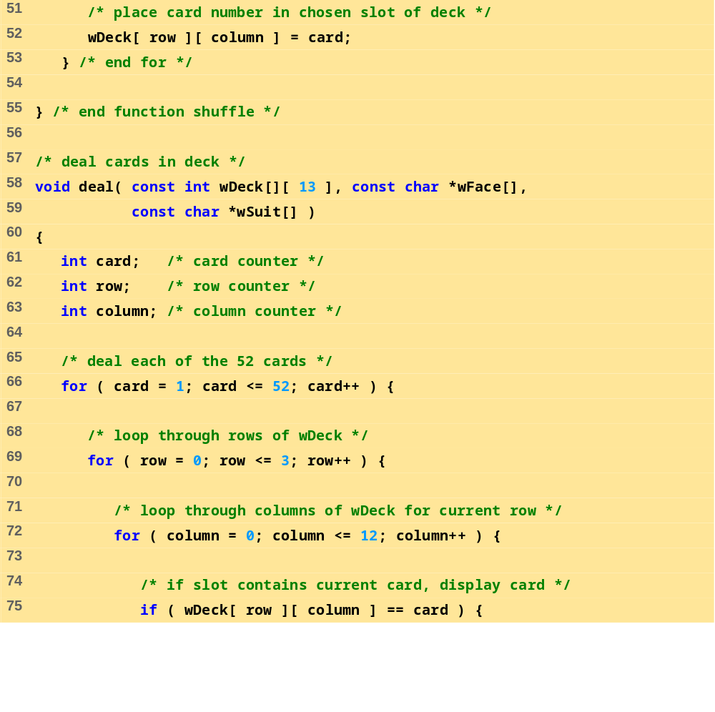
fig07_24.c (Part 3 of 4)

Slide 56
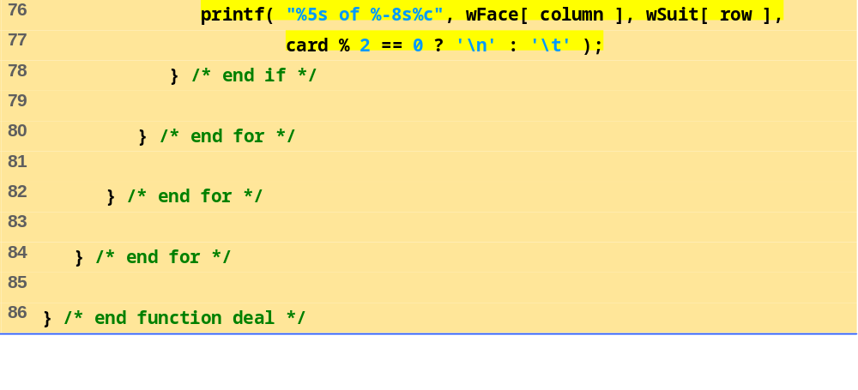
fig07_24.c (Part 4 of 4)

Slide 57
Nine of Hearts Five of Clubs
Queen of Spades Three of Spades
Queen of Hearts Ace of Clubs
King of Hearts Six of Spades
Jack of Diamonds Five of Spades
Seven of Hearts King of Clubs
Three of Clubs Eight of Hearts
Three of Diamonds Four of Diamonds
Queen of Diamonds Five of Diamonds
Six of Diamonds Five of Hearts
Ace of Spades Six of Hearts
Nine of Diamonds Queen of Clubs
Eight of Spades Nine of Clubs
Deuce of Clubs Six of Clubs
Deuce of Spades Jack of Clubs
Four of Clubs Eight of Clubs
Four of Spades Seven of Spades
Seven of Diamonds Seven of Clubs
King of Spades Ten of Diamonds
Jack of Hearts Ace of Hearts
Jack of Spades Ten of Clubs
Eight of Diamonds Deuce of Diamonds
Ace of Diamonds Nine of Spades
Four of Hearts Deuce of Hearts
King of Diamonds Ten of Spades
Three of Hearts Ten of Hearts
Program Output

Slide 58
7.11 Pointers to Functions
Pointer to function
  Contains address of function
  Similar to how array name is address of first element
  Function name is starting address of code that defines function
Function pointers can be
  Passed to functions
  Stored in arrays
  Assigned to other function pointers

Slide 59
7.11 Pointers to Functions
Example: bubblesort
  Function bubble takes a function pointer
    bubble calls this helper function
    this determines ascending or descending sorting
  The argument in bubblesort for the function pointer:
      int ( *compare )( int a, int b )
    tells bubblesort to expect a pointer to a function that takes two ints and returns an int
  If the parentheses were left out:
      int *compare( int a, int b )
    Defines a function that receives two integers and returns a pointer to a int

Slide 60
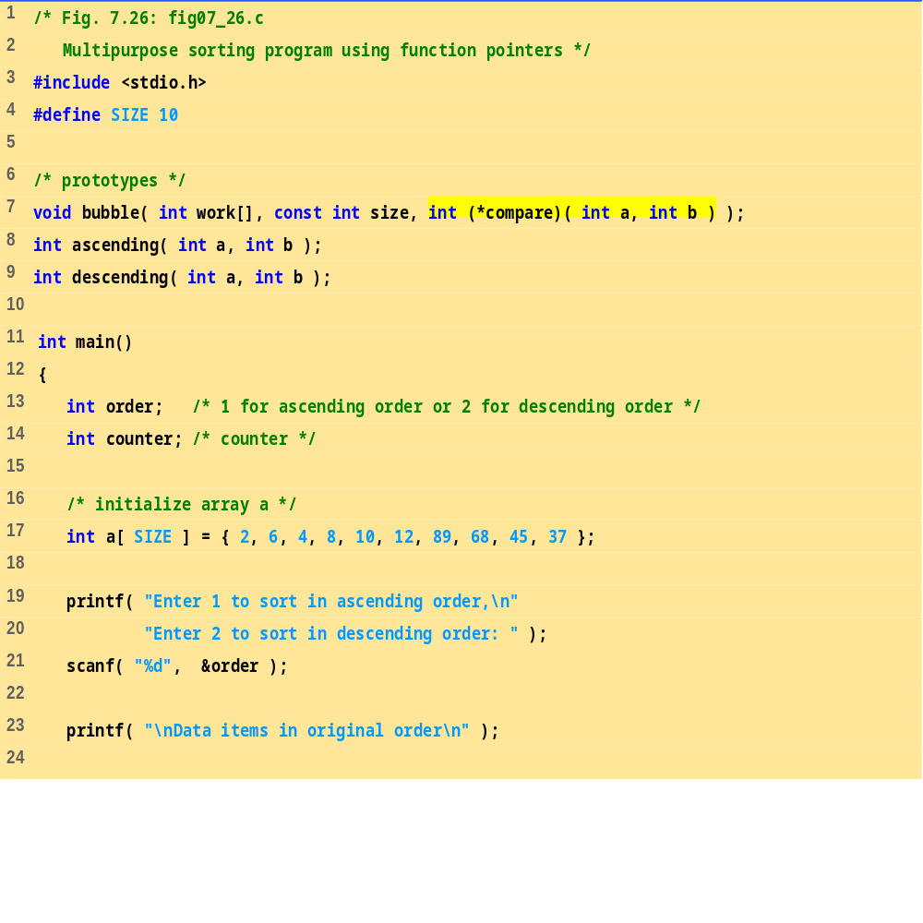
fig07_26.c (Part 1 of 4)

Slide 61
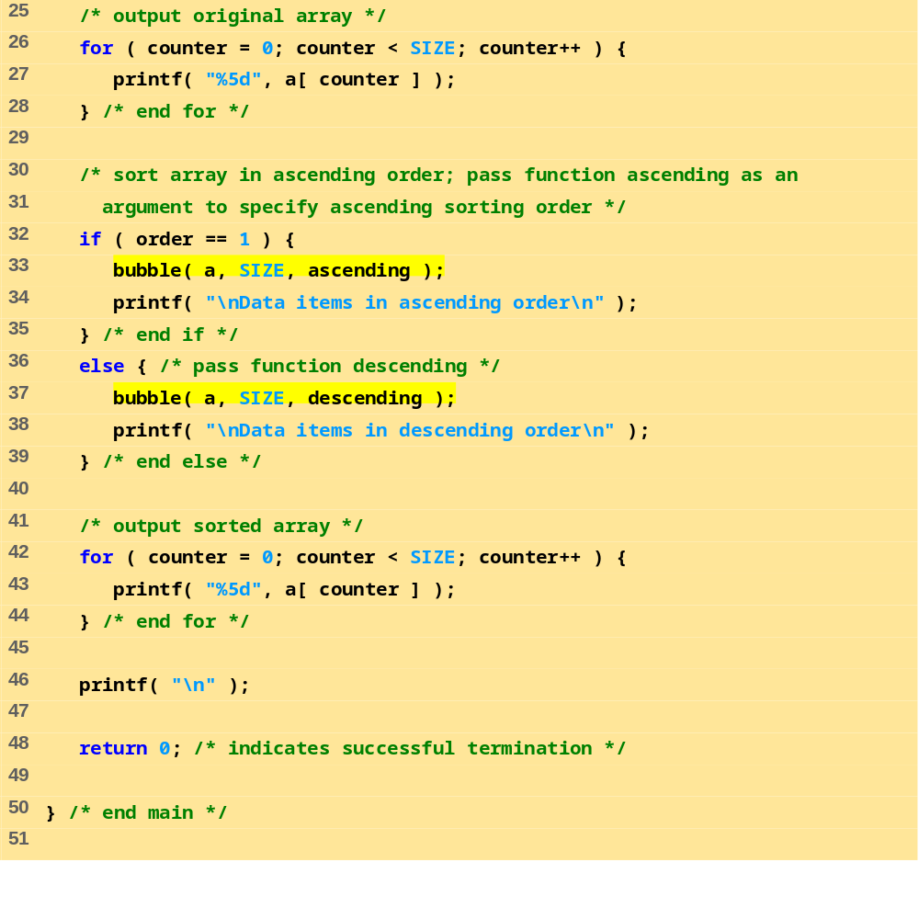
fig07_26.c (Part 2 of 4)

Slide 62
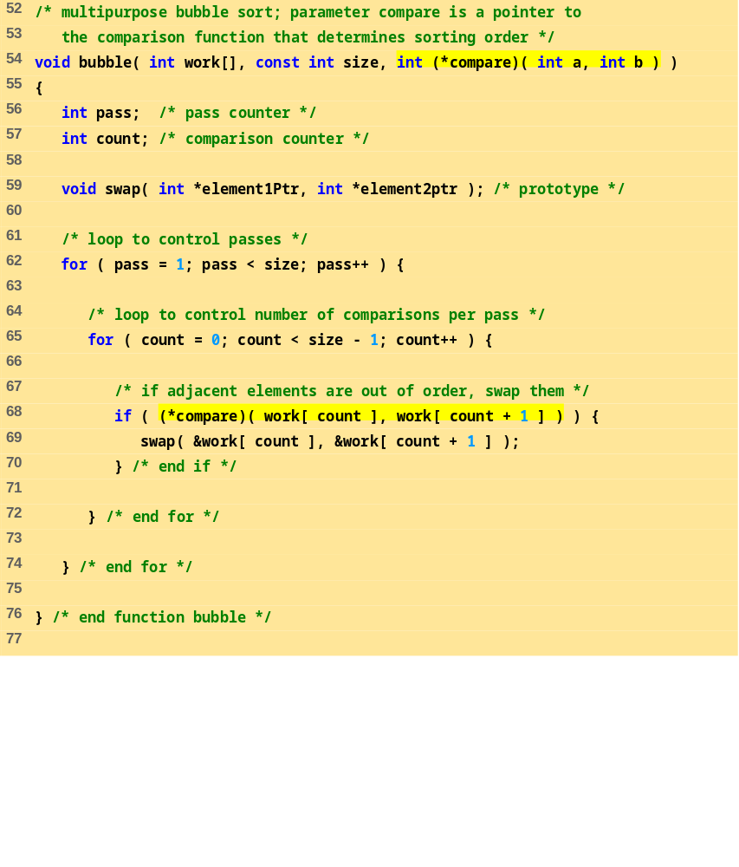
fig07_26.c (Part 3 of 4)

Slide 63
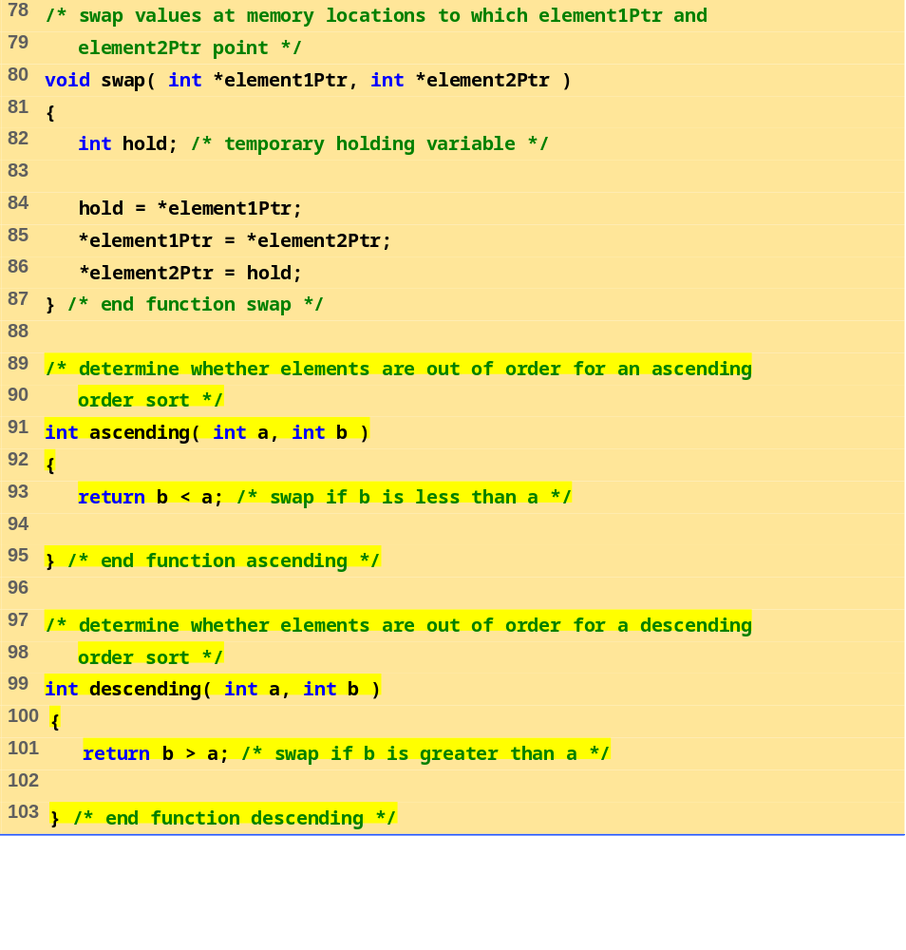
fig07_26.c (Part 4 of 4)

Slide 64
Enter 1 to sort in ascending order,
Enter 2 to sort in descending order: 1
Data items in original order
2 6 4 8 10 12 89 68 45 37
Data items in ascending order
2 4 6 8 10 12 37 45 68 89
Program Output
Enter 1 to sort in ascending order,
Enter 2 to sort in descending order: 2
Data items in original order
2 6 4 8 10 12 89 68 45 37
Data items in descending order
89 68 45 37 12 10 8 6 4 2

